Slide 1
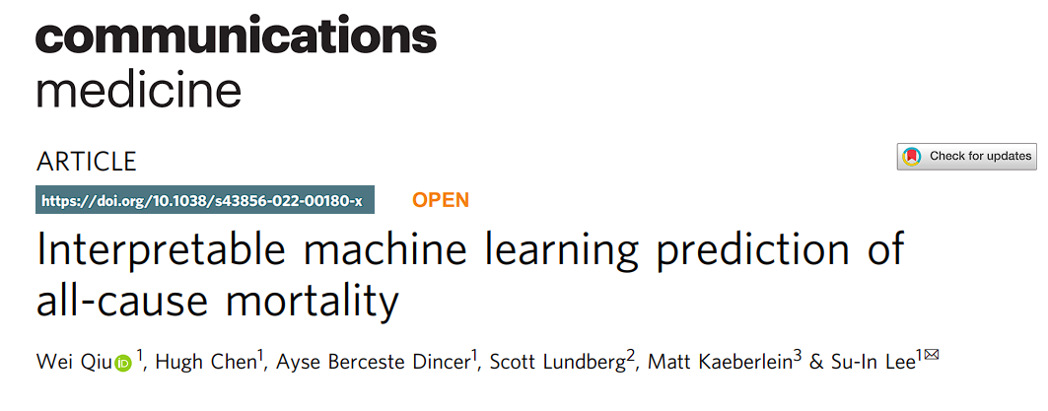
Reporter: Cheng-Hsuan, Wu

Slide 2
Outline
Background
XAI
Motivation
Dataset
Tech
Tree-explainer
Supervised distance
Clustering feature selection
Result
Compare to other method
Explainable result
Feature selection
Disscussion

Slide 3
Motivation
Current death predictor:
Need transform to linear, & need prime knowledge
Can not numerize death prone rate
Can not set reliable death prone region
Can not catch related feature easily (ie. weight, BMI)
Current interpretable model
need to be simple model ie. linear model
Use Gradient boosted tree catch nonlinear relation, without prime knowledge
Use SHAP to numerize death prone rate
Use sharp turns on diagram of SHAP & feature value to set reliable death prone region
Use hierarchical clustering to catch related features

Slide 4
Background_XAI
What is XAI( Explainable AI)
make machine tell why it make the decision upon give feature
Reason for XAI
verification of the system
improvement of the system
compliance to legislation
learning from the system
Common category of XAI
Deep explanation_learning explanation while learning pattern
Model induction_explain black box after learning

Slide 5
Background_XAI
Why XAI important in medcine
Cost of mistake is big_need, reason to decide who should pay responsibility
legislation need explainable reason to protect patients’ right
Human’s ignorance to biology needs improvement learns from XAI

Slide 6
Dataset_train
Feature | Type | Display_Name
Demographics_Age | Demographics | Age
Demographics_Citizenship_2.0 | Demographics | Not a citizen of the US
Questionnaire_AlcoholFreqDays | Questionnaire | Avg # alcoholic drinks/day - past 12 mos
Laboratory_UrineAlbumin | Laboratory | Albumin, urine (ug/mL)
Examination_Weight | Examination | Weight (kg)
151 features
47,261 samples
includes death rate from
take till end of 2015
from 1999-2014
from NHANES
includes Demographics, Examination,
Laboratory,Questionnaire

Slide 7
Dataset_external validation dataset
51 feature overlap
384,762 samples
includes confirmed 5-year mortality status
From UK Biobank

Slide 8
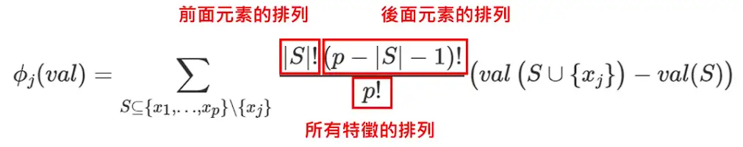
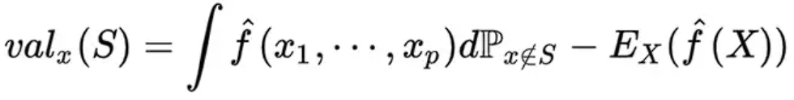
Tech_Tree explainer
SHapley value
預測值減去平均預測值

Slide 9
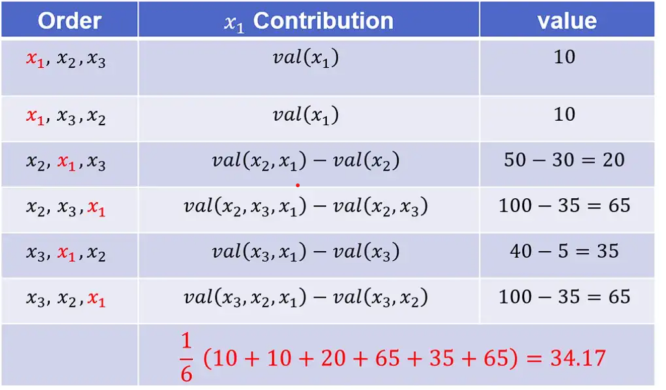
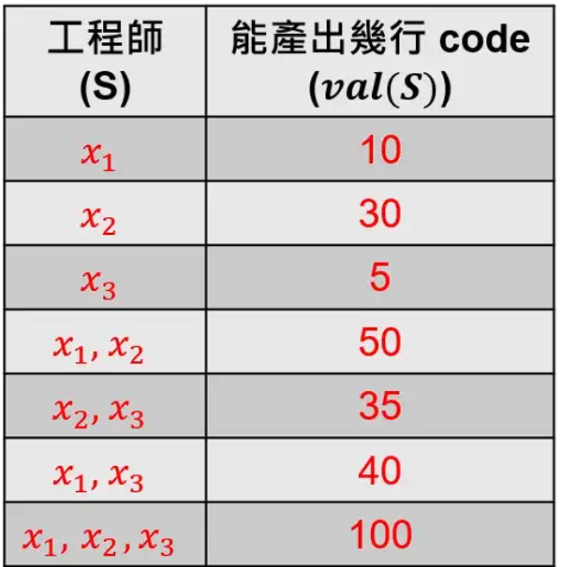
Tech_Tree explainer

Slide 10
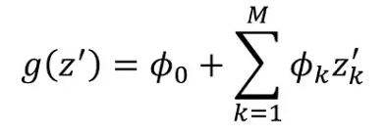

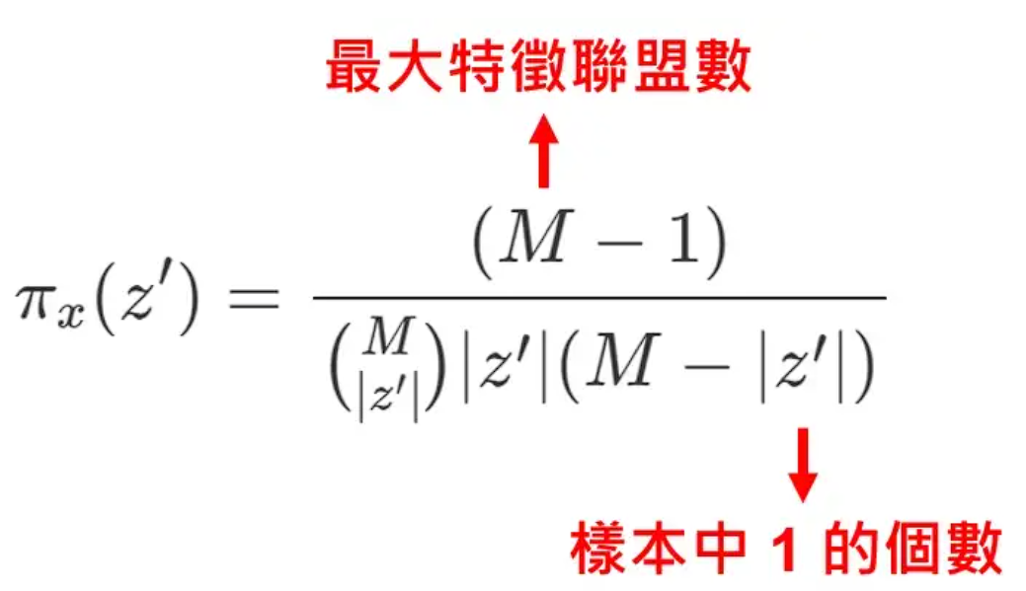
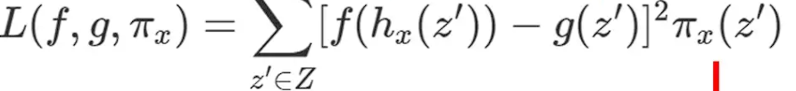
Tech_Tree explainer
Caculate kernal SHAP value
for z_{k} = 0, give random value form data, get prediction with generated features
compute weight ℼ_{x}
min loss function below
parameter Φ is SHAP value (the bigger, the more important

Slide 11
Tech_Tree explainer
Form model simply by gradient boost tree
Caculate SHAP value
Use SHAP as the evaluation of death prone parameter

Slide 12
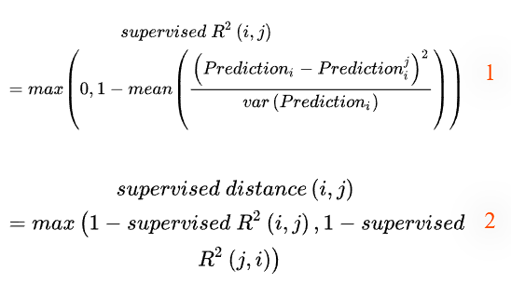
Tech_Supervised distance
Given Gradient boosted tree
Use one feature ture only, other feature use random selection to train single variable model
Use single feature (i) to generate 1-variable model (fits real ans),make pred (i)
Use another feature (j) to generate model (fits pred (i)) and make pred (i,j)
pred (i) - pred (i,j) bigger when less correlated
use var(pred (i)) to cancel effect of broad pred (i)
if pred (i) - pred (i,j) too big, take R² = 0 instead
take the better fit for i→ j or j→ i

Slide 13
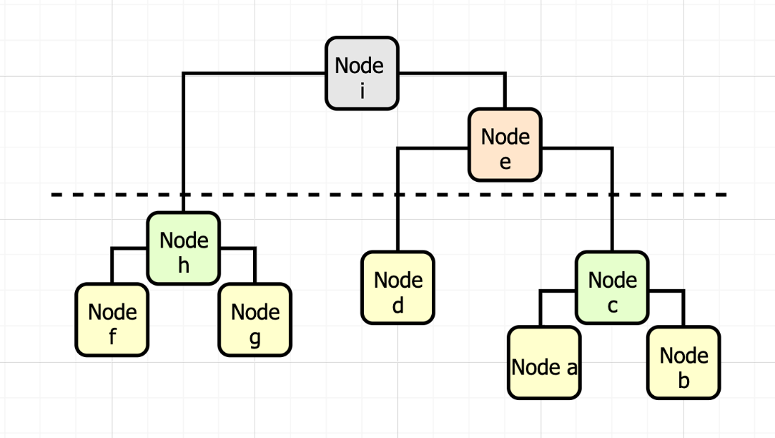
Tech_Clustering feature selection
Form model by all feature
exclude age, sex
caculate average (over 1000 test) SHAP to form order
Use supervised distance to cluster
Pick feature with highest SHAP in each cluster
pick (feature_num - 5) clusters, which kills 5 most correlating features
use rest of feature generate model
repeat until all features cluster to one

Slide 14
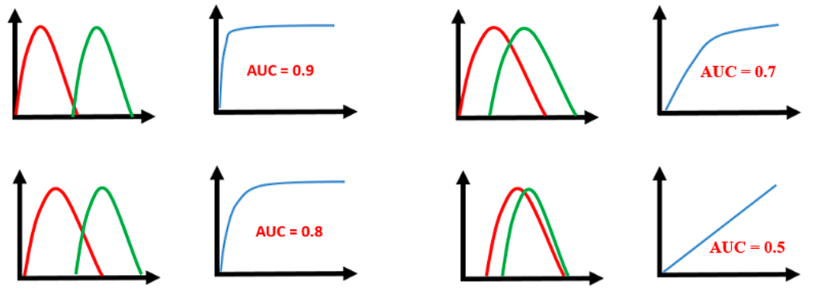
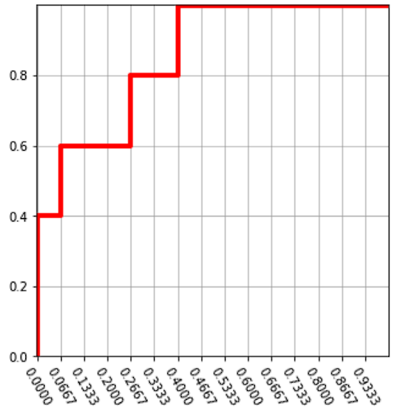
Result_AUROC
For 2 class classifaction (ie. death at specific timepoint)
given positive prediction softmax value
order data from big to small
if prediction gives positive, goes up; else goes right
caculate area under curve
The more significant the classification, the bigger the area

Slide 15
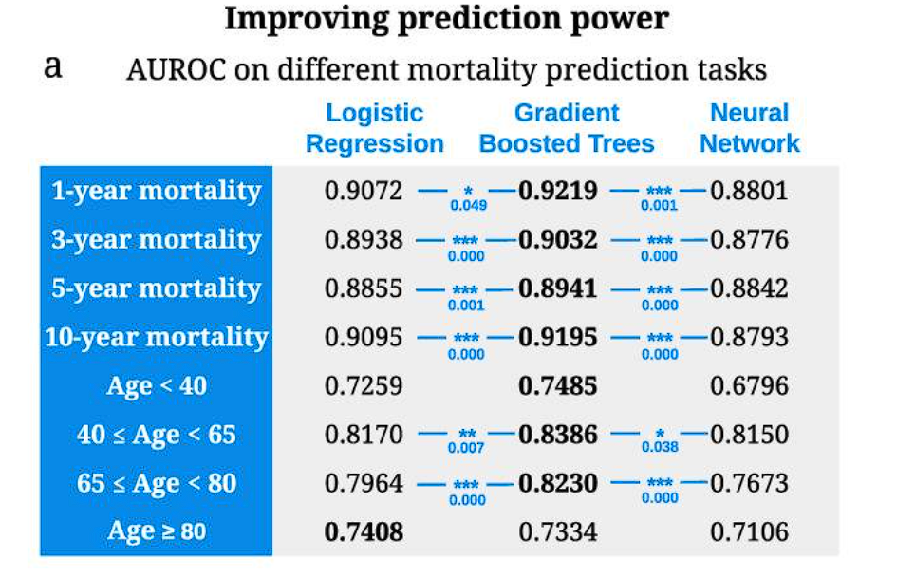
Result_Compare to other method

Slide 16
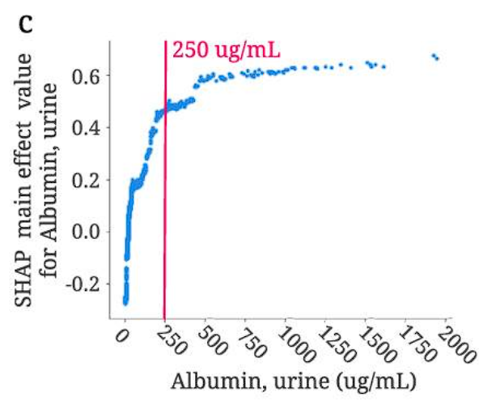
Result_Explainable result
capture nonlinear relation between death & feature
use sharp turns to be the threshold of death prone
explain death prone score feature by feature

Slide 17
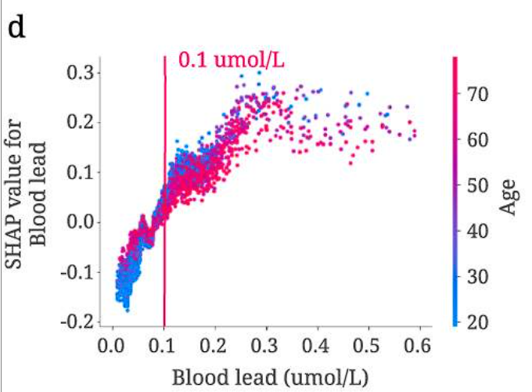
Result_interaction of features

Slide 18
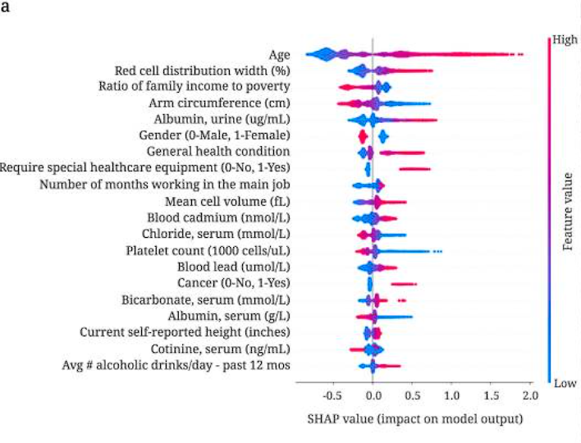
Result_Feature selection
Color: value of feature (ie. 250 ug/ml for urine albumin
Width: amount of samples
SHAP value: Bigger means more important for death prediction

Slide 19
Disscussion
capture nonlinear relation
no need to do transform
give reason in a numerical method (ie. what parameter exceed the standard)
can learn reason without lowering accuracy
dig out more feature than before

